Slide 1
INTERNATIONAL OPPORTUNITIES THROUGH THE BRITISH COUNCIL

Slide 2
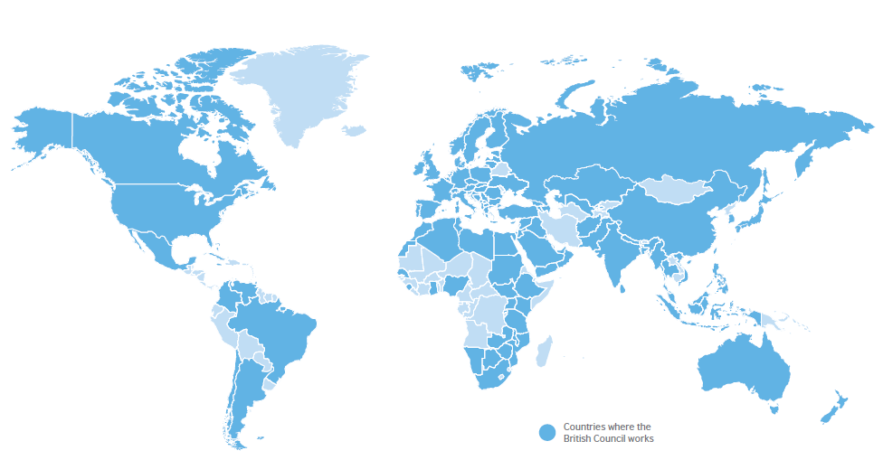
Who we are…
UK's international organisation for educational opportunities and cultural relations
We work across 6 continents in over 100 countries
Areas of work:
- English teaching and exams
Arts
Education and Society

Slide 3
www.britishcouncil.org/study-work-create

Slide 4
What is ‘STUDY WORK CREATE’ ?
British Council’s campaign to internationalise students, young people and young professionals in the UK
Online portal showcasing opportunities to study, work, travel, volunteer or develop creativity abroad
A source of inspiration and practical advice about real life overseas experiences

Slide 5

Types of opportunity we offer

Slide 6
Work English Language Assistants Programme Gain paid experience as a teaching assistant in one of 14 countries across the world, whilst developing language skills and gaining insight into life and work in a different cultural context British Council Future Leaders Scheme Three year programme, open to recent graduates, to develop the next generation of globally mobile cultural relations leaders British Council Summer Internship Scheme Learn new skills on a paid 12 week internship programme, gaining insight into the world of cultural relations
www.britishcouncil.org/study-work-create

Slide 7
Work Erasmus+ traineeships Apply for funding to work in one of 32 European countries for 2-12 months as part of your course Generation UK-China Apply to undertake a 2 month internship in China across a range of industries Generation UK-India Gain experience as a teaching assistant in an Indian private school or on a work 12 month placement with Tata consultancy in a range of disciplines Thailand English Teaching programme (TET) Teach English in a Thai school for between 9 weeks and a term
www.britishcouncil.org/study-work-create

Slide 8
Study Erasmus+ Spend between 3-12 months studying abroad as part of your university course in a choice of 32 countries in Europe Generation UK-China Scholarships Students and recent graduates can apply for scholarships to study in China for 5-12 months Generation UK-India Take part in a short 2-3 week study placement
www.britishcouncil.org/study-work-create

Slide 9
Why go abroad?
Confidence, Independence, Social skills, Cultural awareness, Communication skills, Planning skills, Organisational skills, Patience, Adaptability, Public speaking experience, Ability to live abroad, Improved language skills, Self-sufficiency, Self-reliance, Budgeting skills, Ability to live alone, Maturity, Resilience, Initiative, Teamwork skills, Open-mindedness, Time management skills, Assertion, Self-Knowledge, Resourcefulness, Presentation skills, Perseverance, Ability to cope in a wide range of situations, Tolerance, Problem-solving, Self-motivation, Diplomacy, Leadership, Creativity, Professional work experience, Listening skills, Negotiation skills, Research skills, Ability to improvise
www.britishcouncil.org/study-work-create

Slide 10
a lower proportion of graduates who had been mobile were unemployed
a higher proportion of graduates who had been mobile were in more senior roles
the average salary for graduates who had been mobile was higher if they were working in the UK
a higher proportion of graduates who had been mobile working abroad
Go International report 2013-14
www.britishcouncil.org/study-work-create

Slide 11
SUPPORT FOR LANGUAGE LEARNING:
lEFèVRE FUNDING
The Lefèvre Trust enables pupils (aged 11-19) and teachers from the UK and France to work together on joint projects
UK schools with French partners can apply for a grant of £5000 each to facilitate reciprocal exchange visits
Visits allow pupils to experience the culture and language of another country and allow teachers to learn from different education practices, leading to improvement in teaching and improved learning outcomes for pupils
Partnership projects must be cross-curricular

Slide 12
SUPPORT FOR LANGUAGE LEARNING:
Charles de gaulle FUNDING
The Charles de Gaulle Trust enables pupils (aged 17-19) and teachers from the UK and France to work together on joint projects
UK schools with French partners can apply for a grant of £5000 each to facilitate reciprocal exchange visits
Pupils do not need to be working towards a French language qualification to participate, however, partnership activities must provide opportunity for pupils to develop French as a core employability skill
Partnership activities must include engagement with the world of work and opportunity to experience the workplace in France

Slide 13
FURTHER INFORMATION AND SUPPORT
Lefèvre Trust:
https://schoolsonline.britishcouncil.org/about-schools-online/about-programmes/french-exchange/lefevre
Charles de Gaulle Trust:
https://schoolsonline.britishcouncil.org/programmes-and-funding/charles-de-gaulle
Support with partner finding: Satya.Roberts@britishcouncil.org
Deadline: 17 May 2016

Slide 14


Schools ONLINE
‘One stop shop’ for teachers
Online portal showcasing opportunities and resources on offer
To register and find out more visit:
www.britishcouncil.org/schoolsonline

Slide 15


Northern Ireland newsletter for teachers
Stay up to date with the latest opportunities
Tailored for Northern Ireland schools
Free to sign up:
https://schoolsonline.britishcouncil.org/
sign-up-to-schools-online-news

Slide 16
Further information:
Louise Murray
Education Manager
Louise.Murray@britishcouncil.org

